Slide 1
Data Science Project (EMATM0047)
Project: Student Dropout Predictor.
Ali Suhail: dy24009@bristol.ac.uk

Slide 2
Problem Description
The main objective is to predict student dropout in higher education through machine learning, with the aim of enabling early interventions and improving student retention.
This will be formulated as a binary classification task, where the model predicts whether a student is likely to dropout or continue (including failures), ideally making this prediction by the midpoint of the module or earlier.

Slide 3
Methodology
Dataset: OULA dataset (assessments, VLE, demographics) structure and key features.
Preprocessing & Feature Engineering: Merge tables into one dataset, segment into four phases (early, midpoint, late and full), clean and prepare data.
Processing: Handle missing values, remove duplicates, impute data, create train/test splits, scale and encode features.
Exploratory Data Analysis: Detailed feature insights.
Modelling: Initialise, tune, execute, and evaluate ML models; pipeline setup and hyperparameter tuning.
Results: Hypothesis testing outcomes and model evaluation.

Slide 4
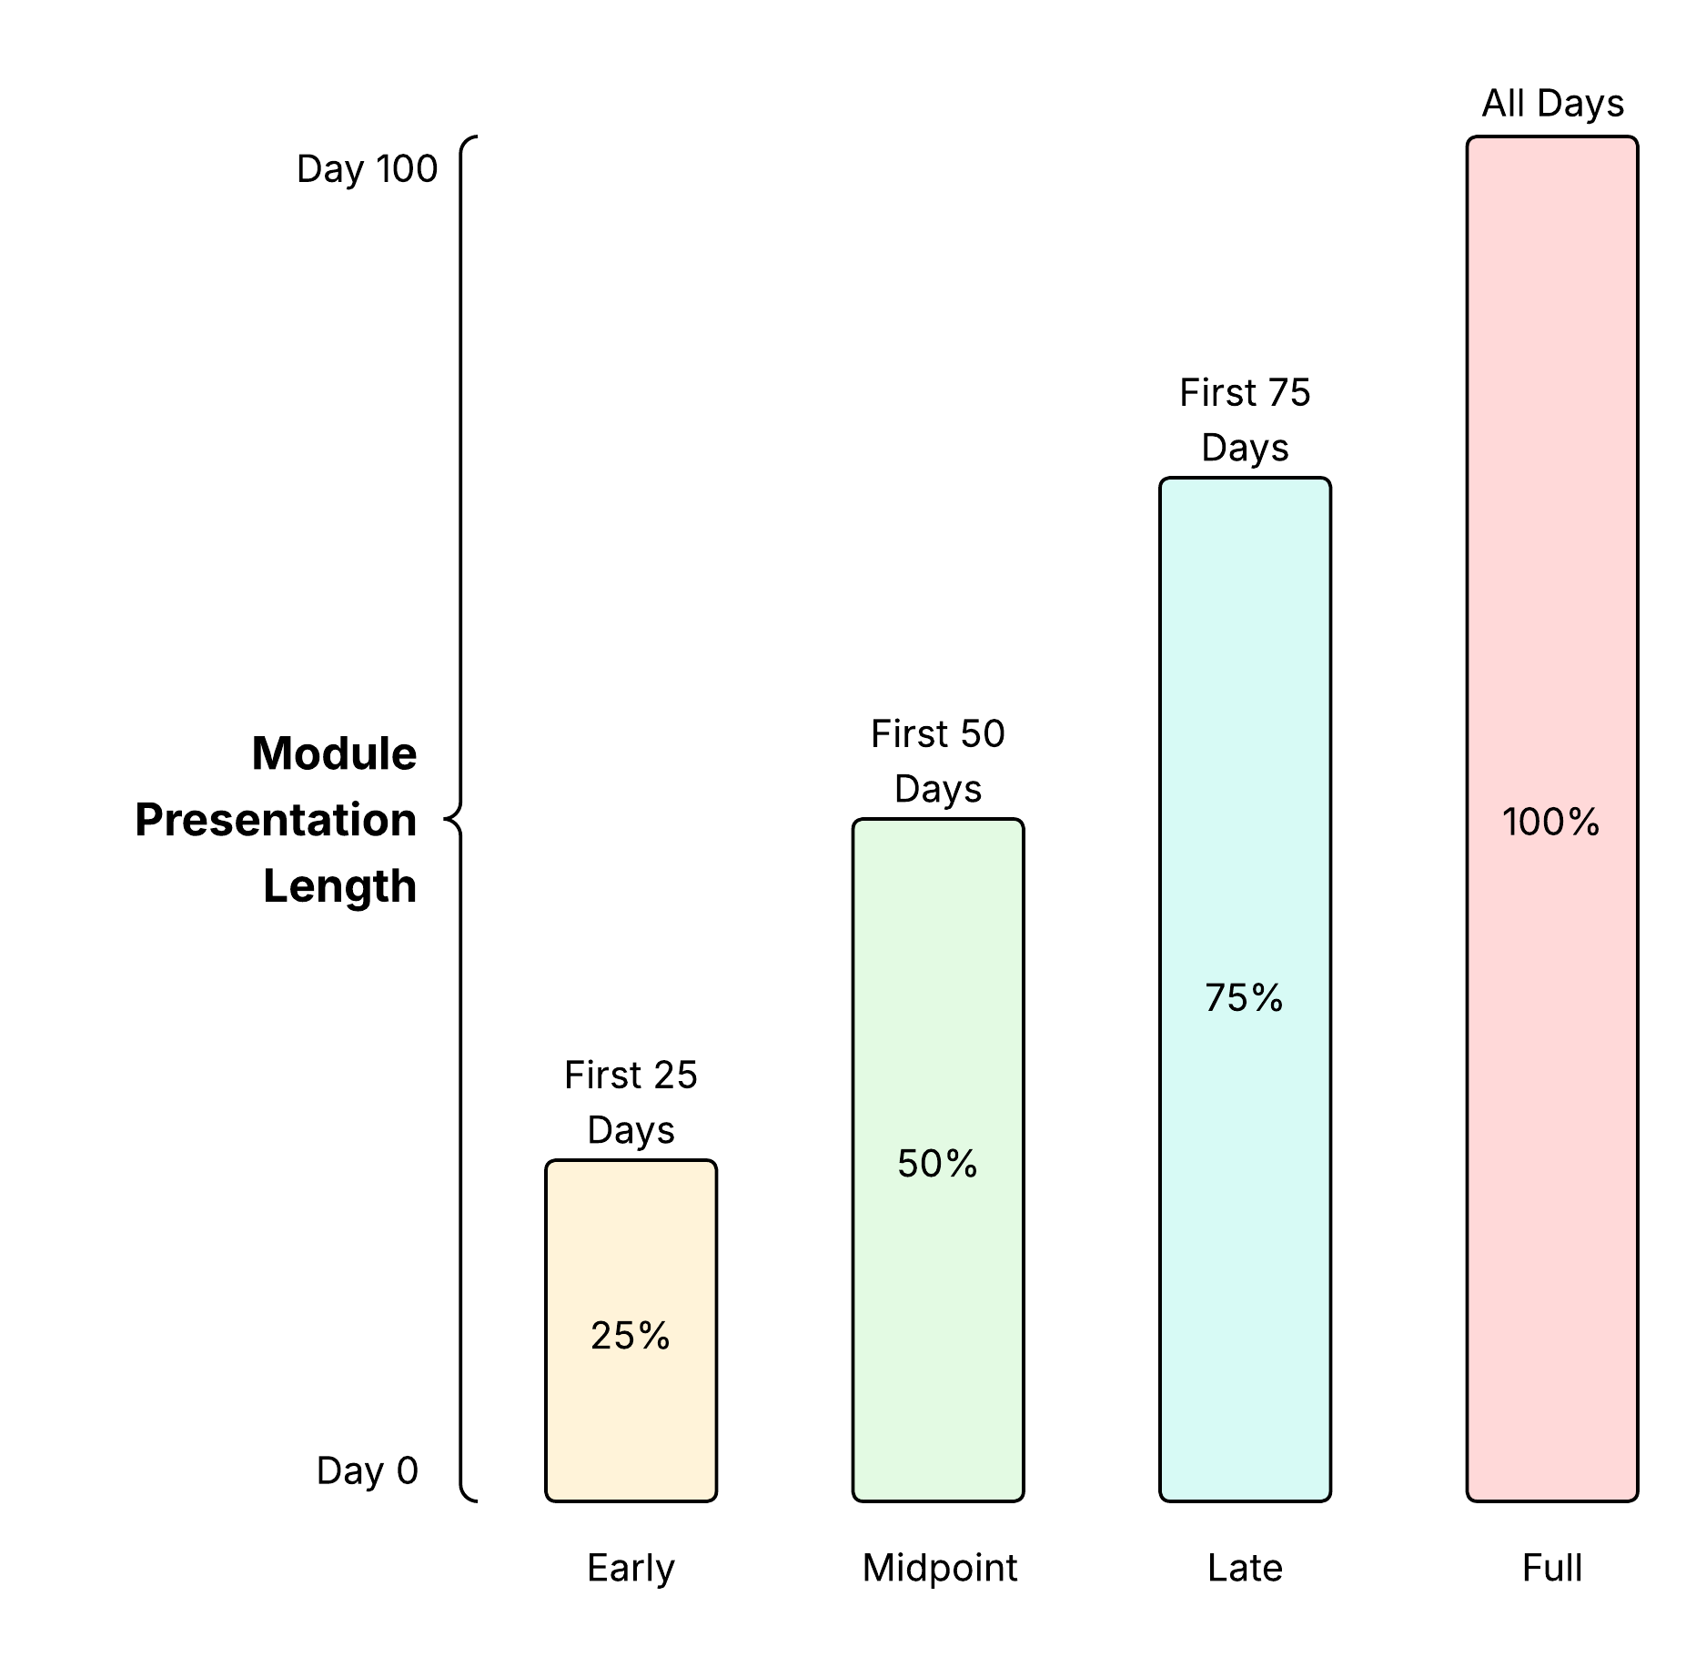
Methodology
Created 4 aggregated features: weighted score, late rate, fail rate, days active and a combined weight-score metric to simplify time-series data for ML.
Temporal segmentation proved to be an effective strategy for enabling earlier interventions. Both [1] and [2] used time-based partitioning successfully, allowing predictions at different points in a module's progression. This makes it possible for institutions to provide timely support before students fall too far behind.
Unlike prior studies focusing on pass/fail, this work targets continue/dropout classification for a new perspective.

Slide 5
Methodology
Dataset has a 20/80 dropout to non-dropout ratio, so class weights were set to 'balanced' to improve minority class detection.
GridSearch with 5-fold cross-validation was used for hyperparameter tuning to ensure stable and accurate results.*
F1 macro was the main evaluation metric due to its emphasis on minority classes, with additional analysis on accuracy, F1, precision, and recall per class, focusing on dropout precision and recall.

Slide 6
Motivation
Student dropout is a major concern in higher education, affecting both students’ academic progress and institutional stability.
In the UK, data from the Student Loans Company shows that students who took loans but did not complete their degrees rose from 32,491 in 2018–19 to 41,630 in 2022–23, a 28% increase. Factors such as mental health challenges, financial strain, academic pressure, social isolation, and limited institutional support contribute to early withdrawal [3], highlighting the need for systems that identify vulnerable students and provide personalised support.
Early identification of at-risk students enables timely, targeted interventions to improve retention and success.

Slide 8
Model Accuracy Scores Across Phases
Model | Early | Midpoint | Late | Full
Logistic Regression | 75% | 79% | 80% | 82%
Support Vector Machine | 82% | 83% | 84% | 86%
Multiplayer Perceptron | 77% | 80% | 82% | 83%
SVM consistently achieves the highest accuracy across all phases, followed by the MLP classifier and then LR.
However, accuracy alone is not a reliable metric for evaluating dropout prediction due to the class imbalance in the dataset, which biases results toward the majority class (non-dropouts).
To better assess model performance on the minority class (dropouts), we focus on the precision and recall scores.

Slide 9
Model Accuracy Scores Across Phases
Model | Early | Midpoint | Late | Full
Logistic Regression | 75% | 79% | 80% | 82%
Support Vector Machine | 82% | 83% | 84% | 86%
Multiplayer Perceptron | 77% | 80% | 82% | 83%
SVM consistently achieves the highest accuracy across all phases, followed by the MLP classifier and then LR.
However, accuracy alone is not a reliable metric for evaluating dropout prediction due to the class imbalance in the dataset, which biases results toward the majority class (non-dropouts).
To better assess model performance on the minority class (dropouts), we focus on the precision and recall scores.

Slide 10
Model F1 Scores Across Phases
Model | Early | Midpoint | Late | Full
Logistic Regression | 51% | 60% | 63% | 67%
Support Vector Machine | 39% | 49% | 57% | 63%
Multiplayer Perceptron | 38% | 47% | 56% | 58%
LR outperforms the other models in terms of macro F1 score across all phases, with SVMs ranking second and MLP showing the lowest overall performance.

Slide 11
Next Steps
Complete Model evaluation.
Complete Hypothesis tests.
Start work on the final report.

Slide 12
Reference
[1] H. Waheed, S.-U. Hassan, Naif Radi Aljohani, J. Hardman, Salem Alelyani, and R. Nawaz, “Predicting academic performance of students from VLE big data using deep learning models,” Computers in Human Behavior, vol. 104, pp. 106189–106189, Nov. 2019, doi: https://doi.org/10.1016/j.chb.2019.106189.
[2] M. Adnan et al., “Predicting at-Risk Students at Different Percentages of Course Length for Early Intervention Using Machine Learning Models,” IEEE Access, vol. 9, pp. 7519–7539, 2021, doi: https://doi.org/10.1109/access.2021.3049446.
[3] J. Bryson, “University dropout rates reach new high, figures suggest,” BBC News, Sep. 28, 2023. https://www.bbc.co.uk/news/education-66940041.

Slide 13
Q&A

